Slide 1
Android: Consuming Web Services (on Apache Tomcat)
Chapter(24)

Slide 2
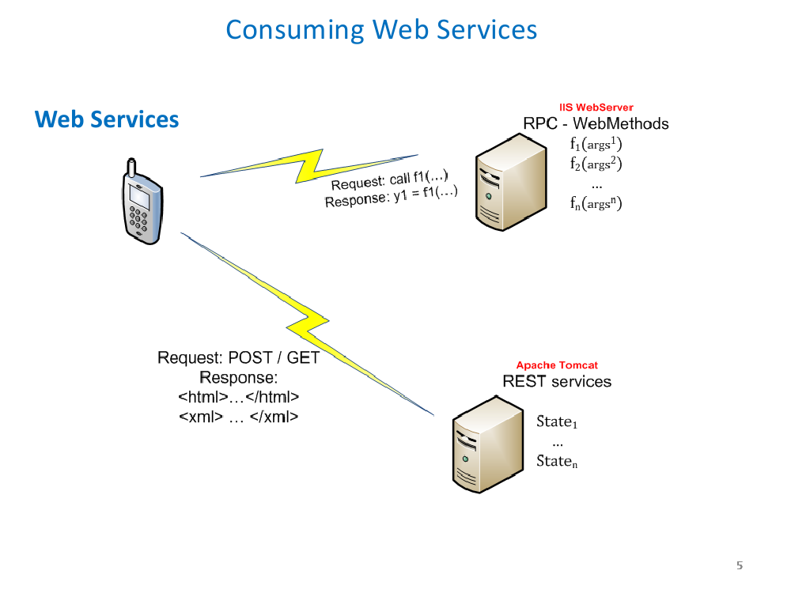

Slide 3
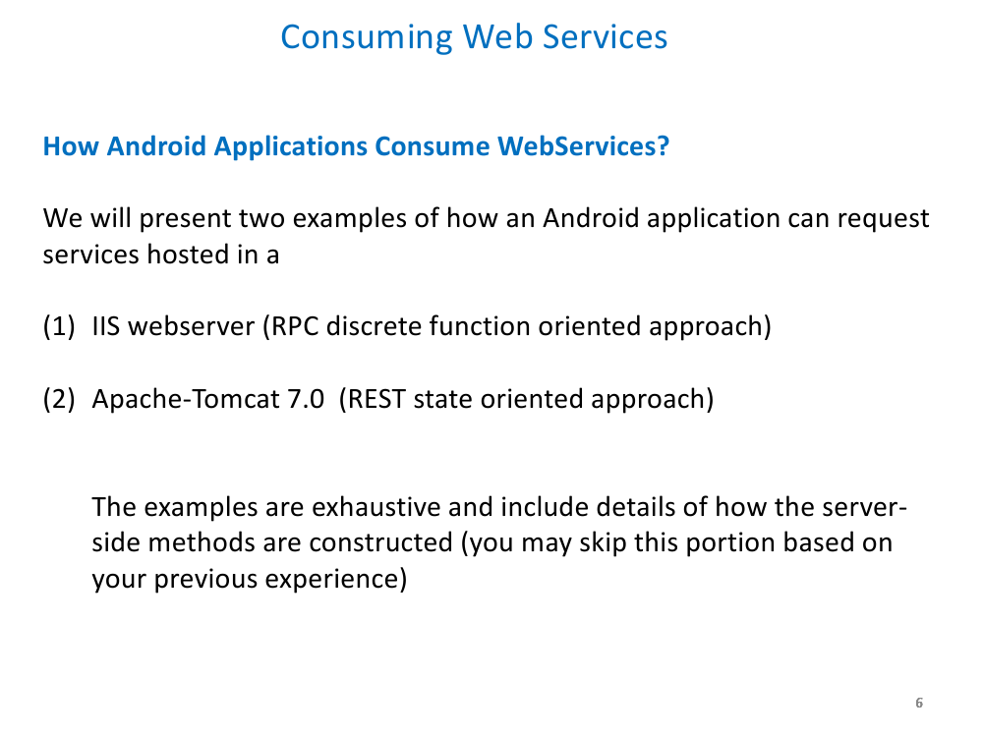

Slide 4
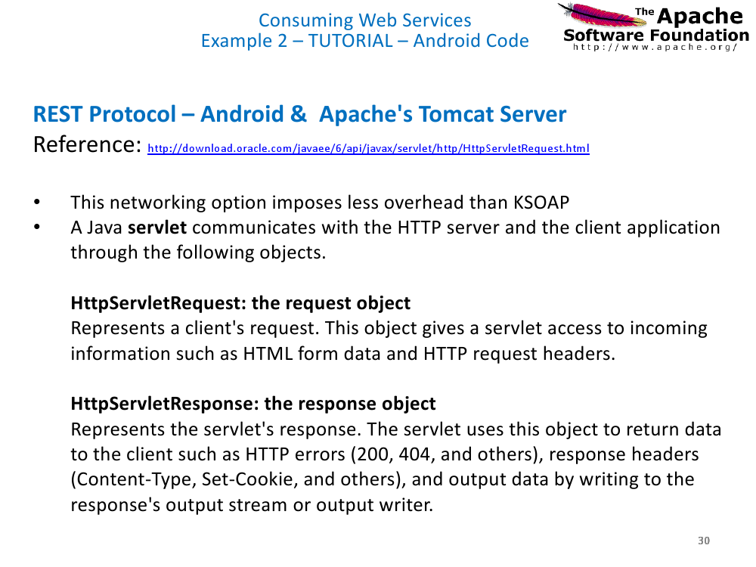

Slide 5
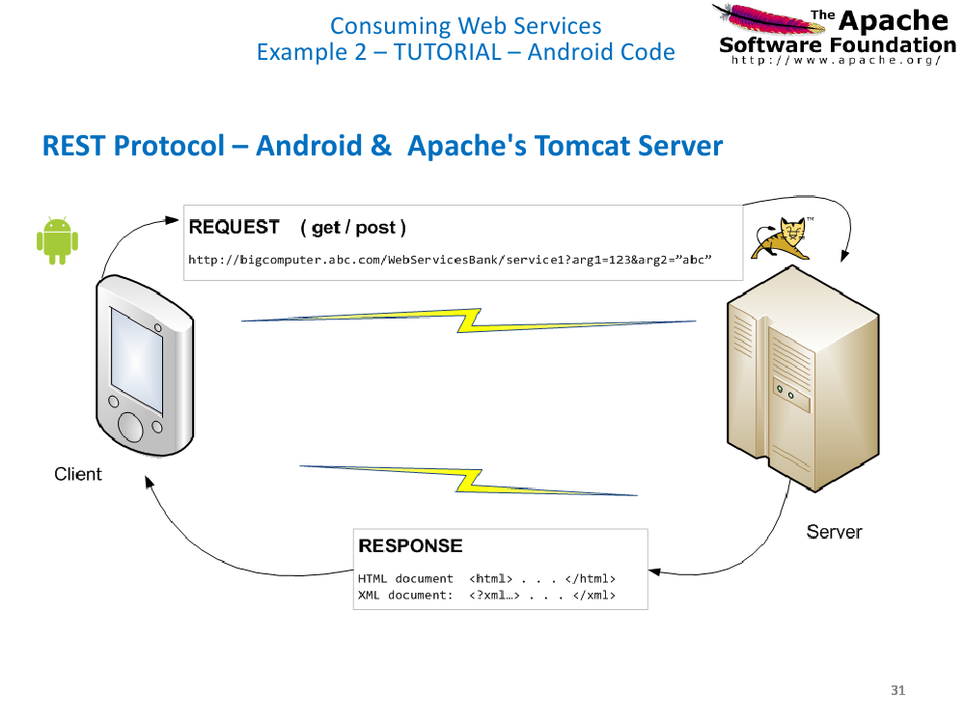

Slide 6
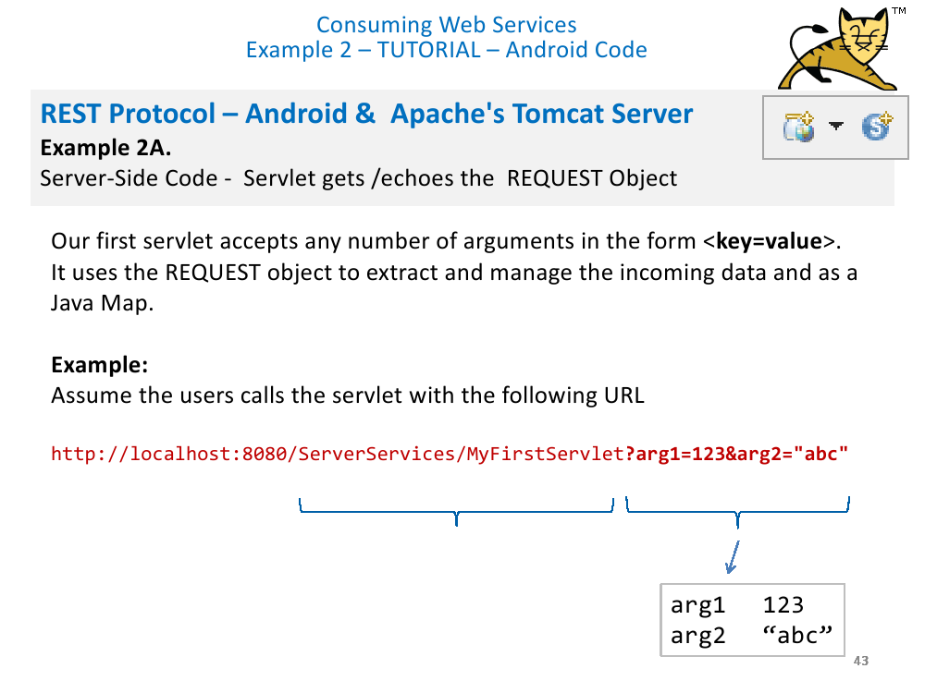

Slide 7
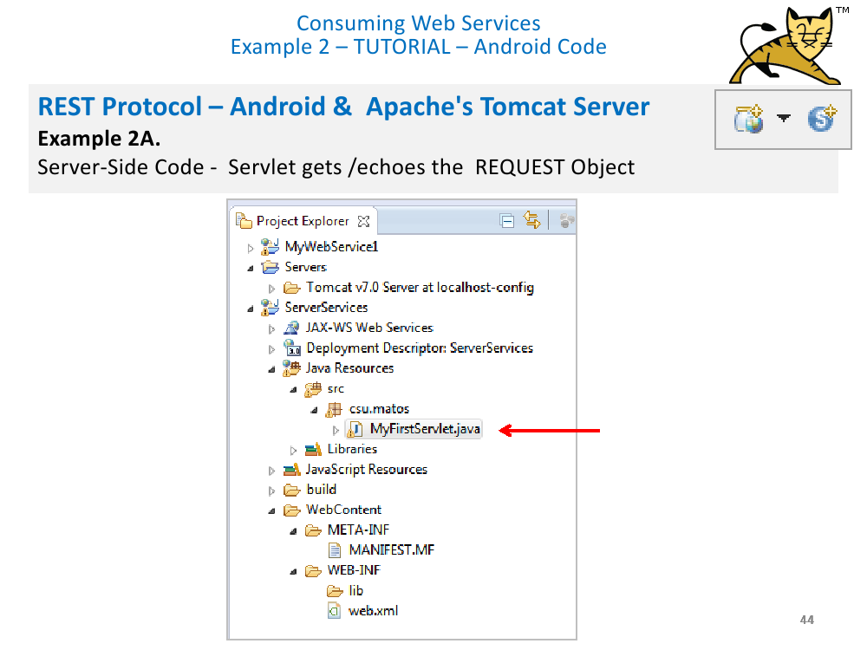

Slide 8
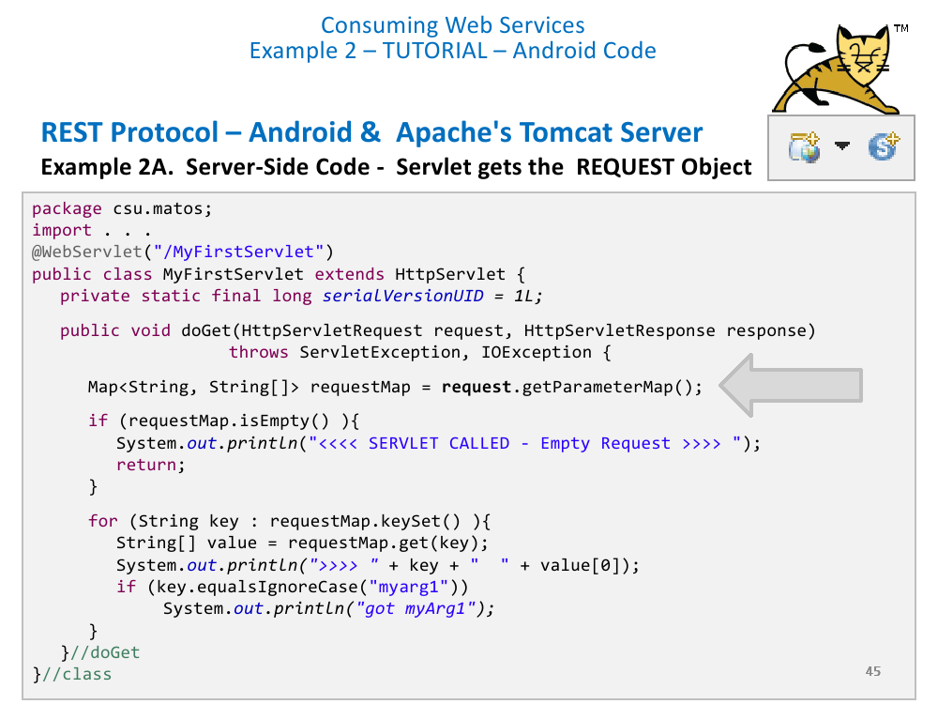

Slide 9
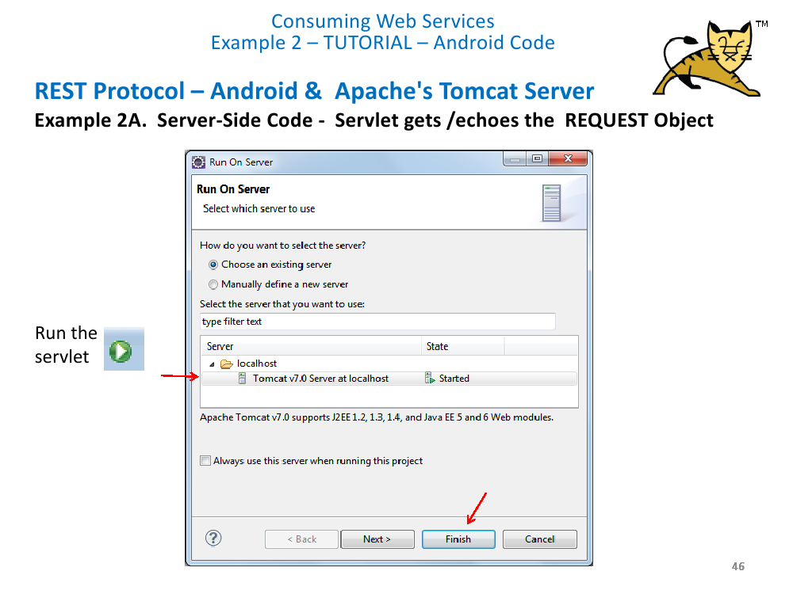

Slide 10
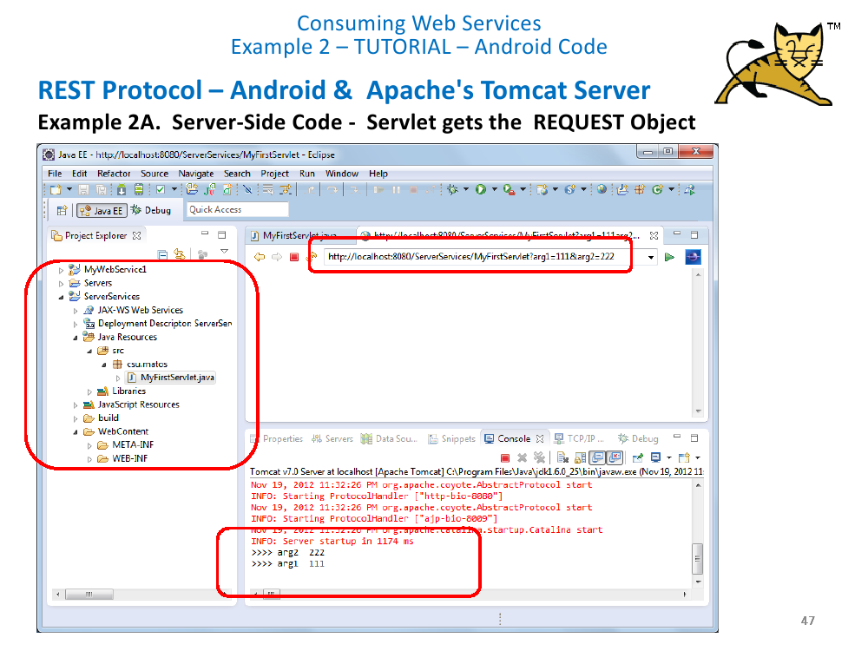

Slide 11
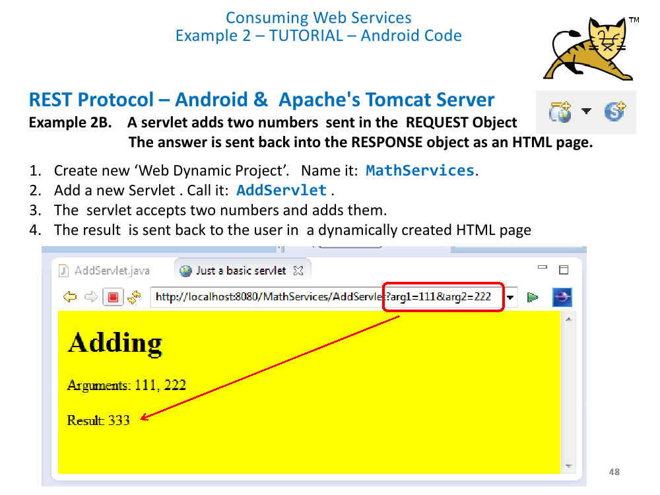

Slide 12
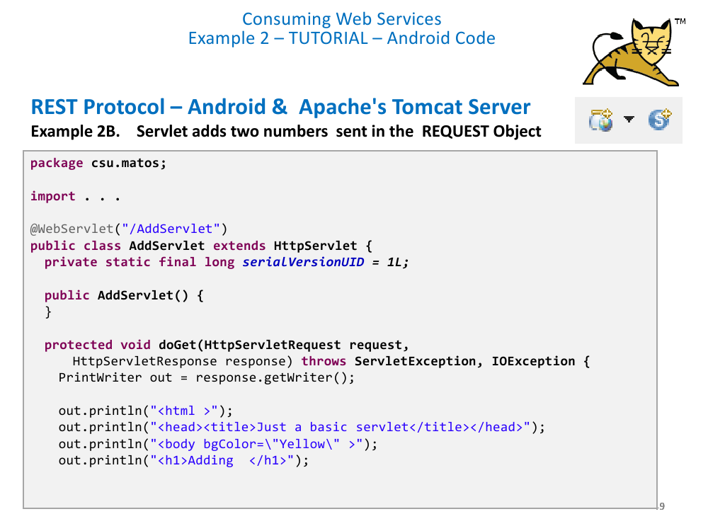

Slide 13
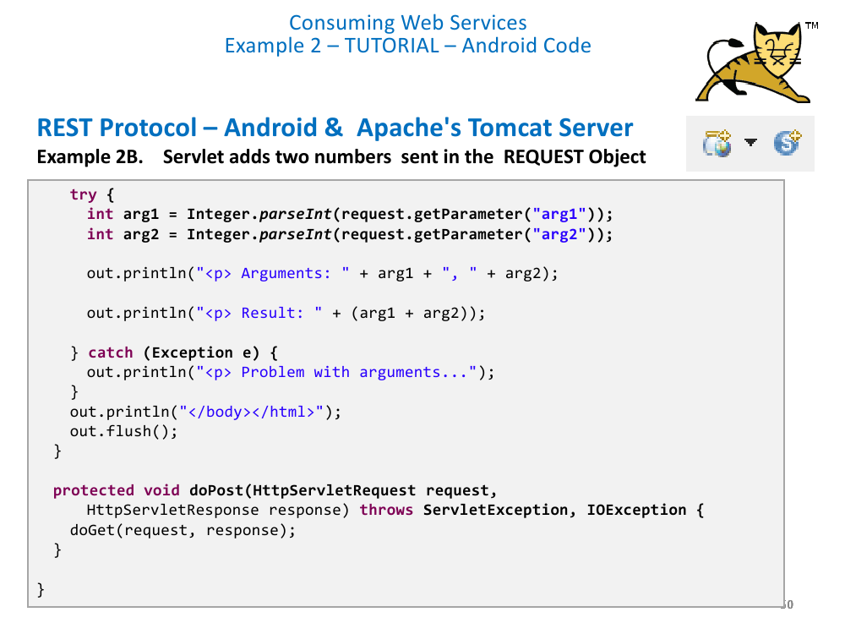

Slide 14
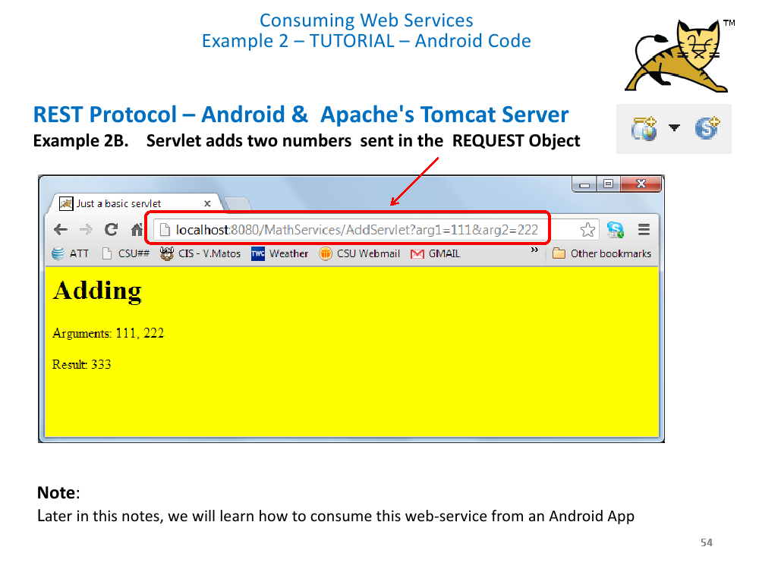

Slide 15
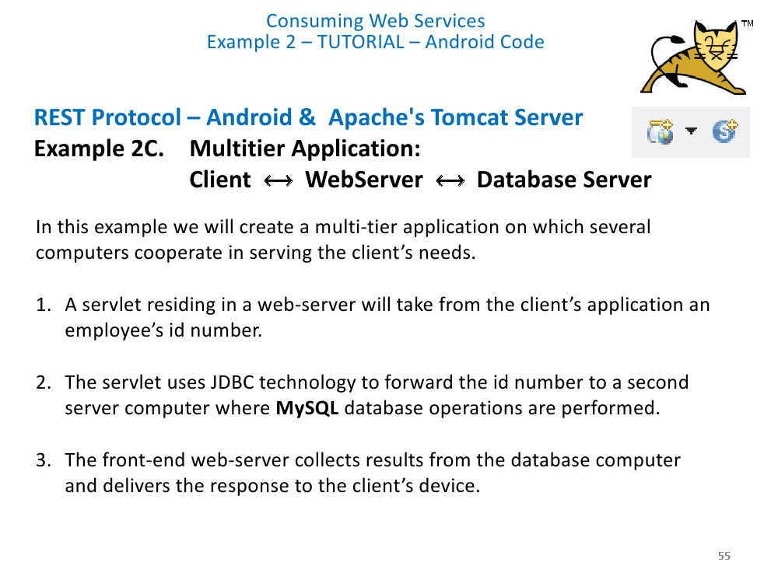

Slide 16
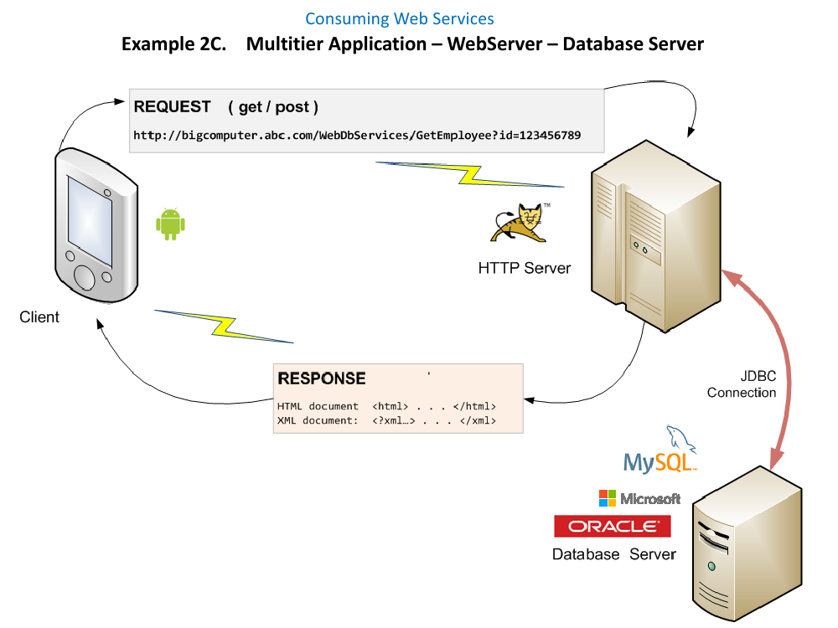

Slide 17
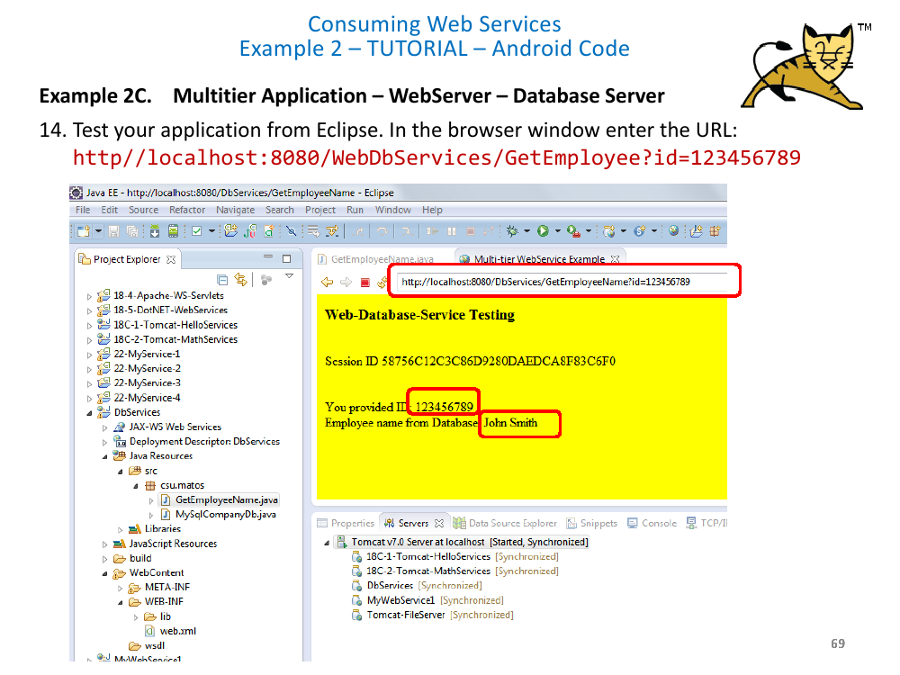

Slide 18
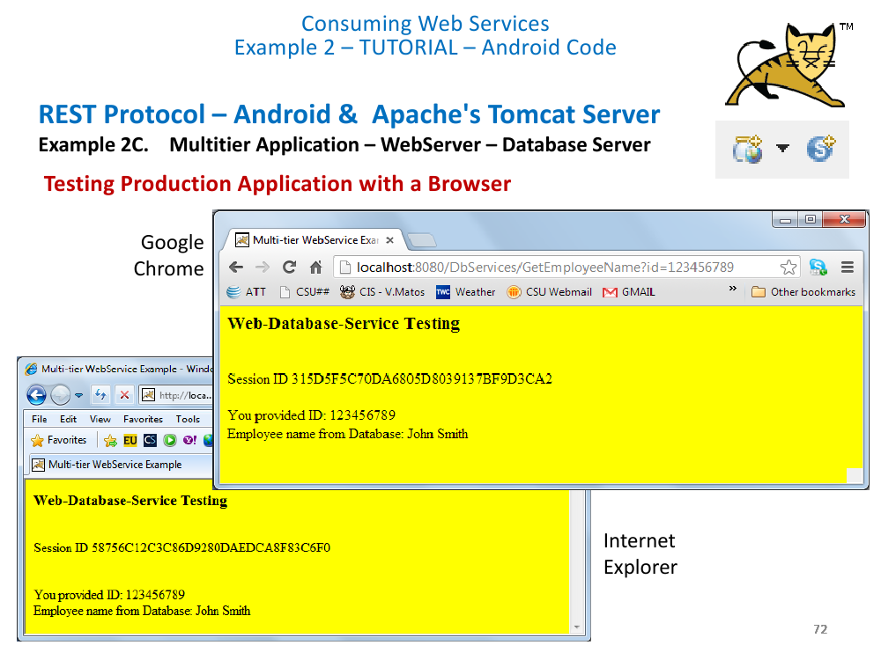

Slide 19
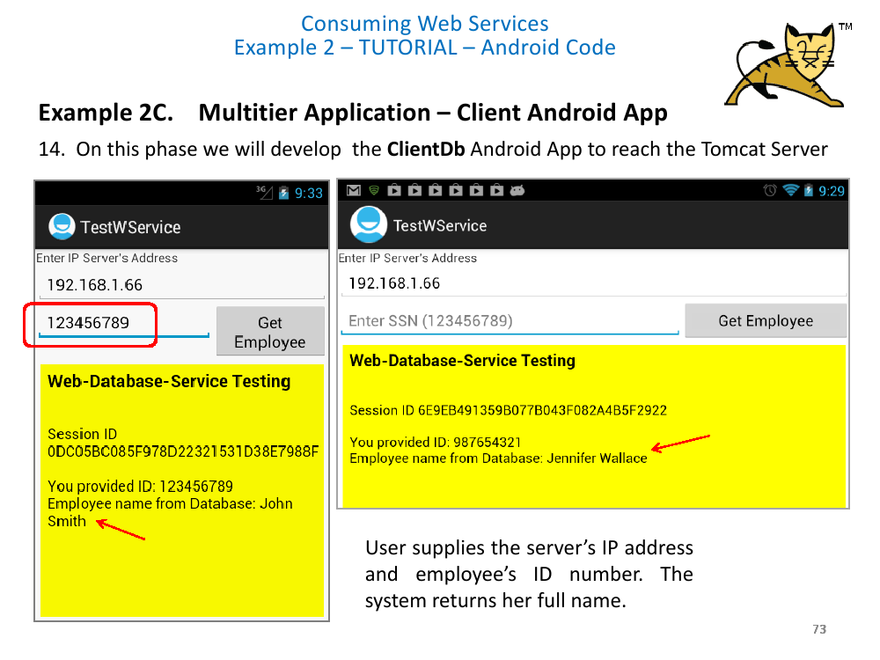

Slide 20
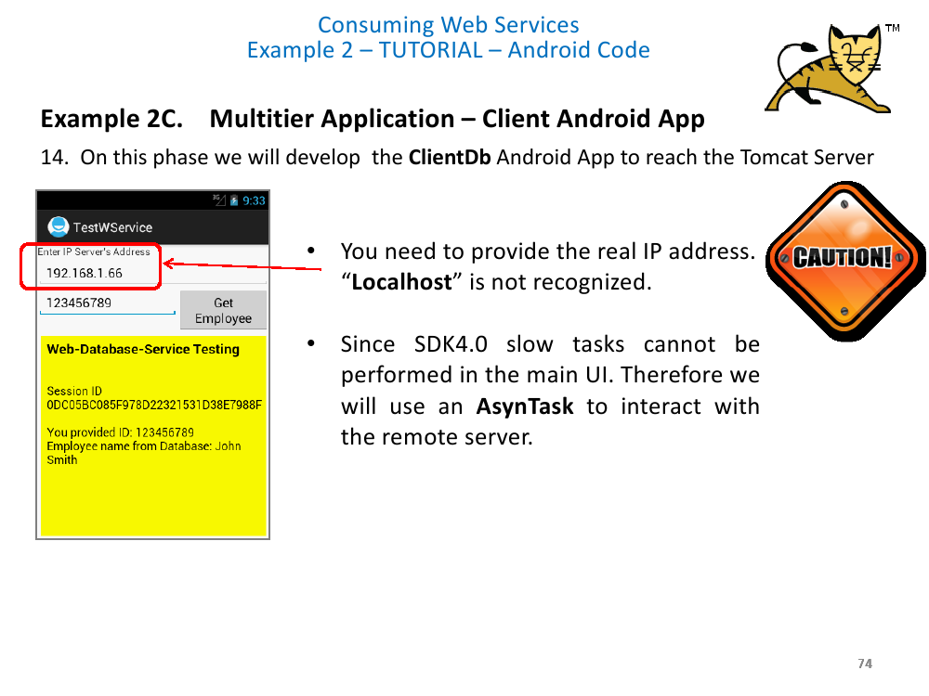

Slide 21
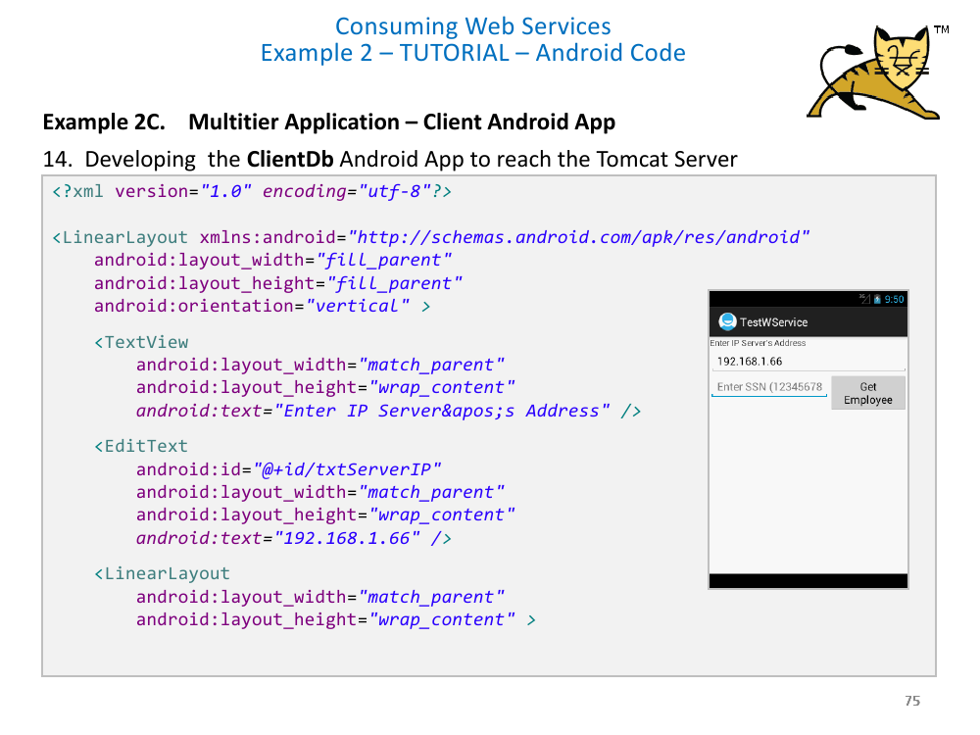

Slide 22
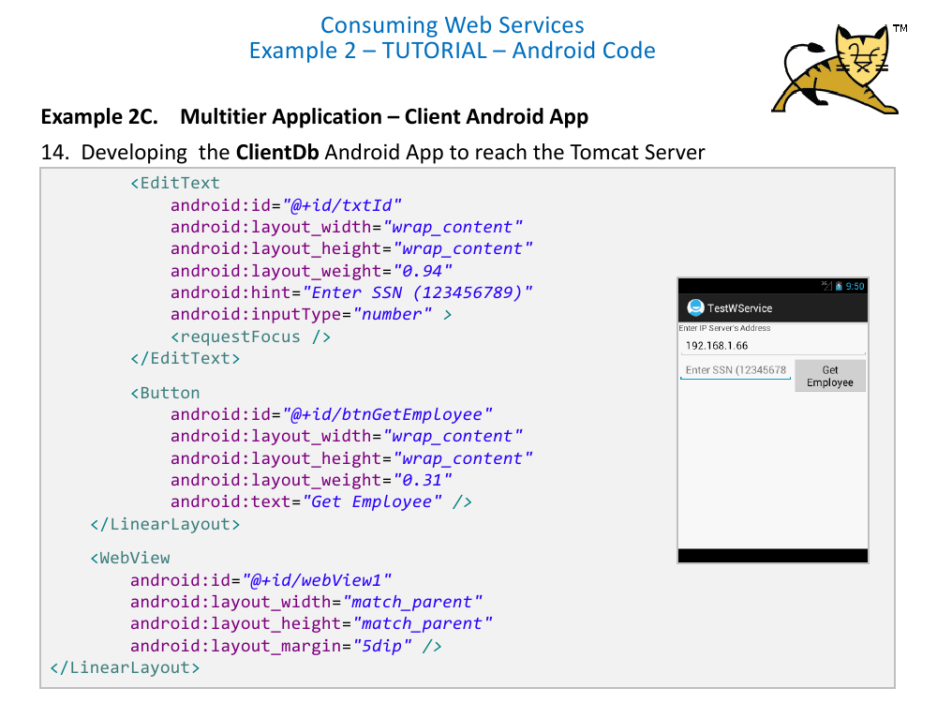

Slide 23
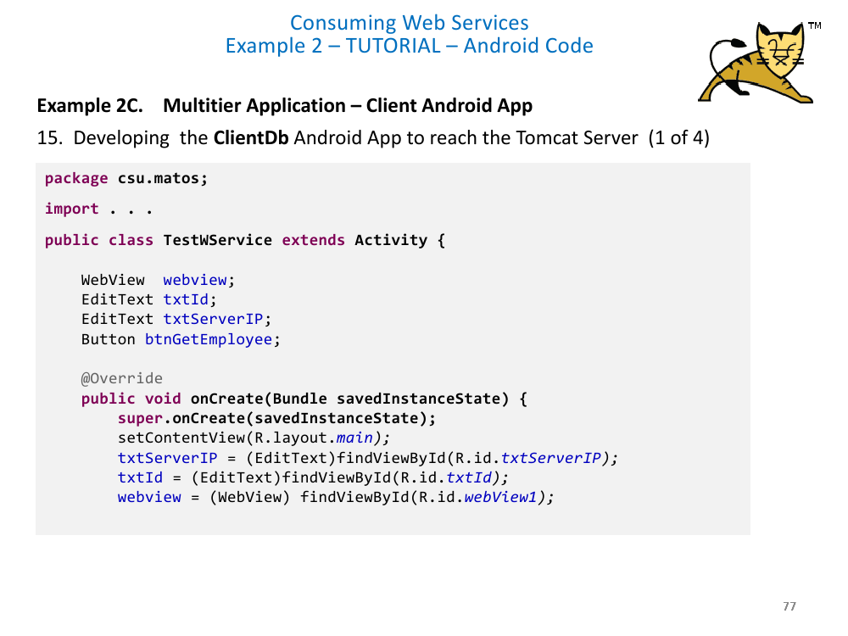

Slide 24
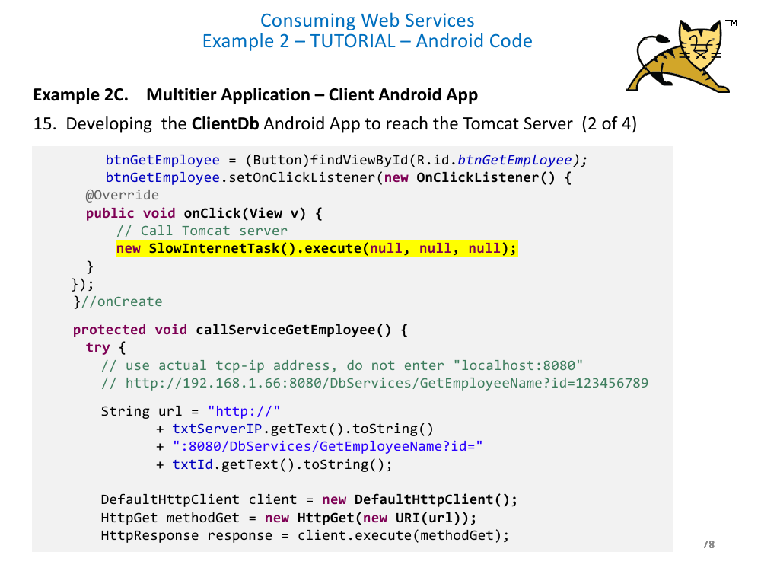

Slide 25
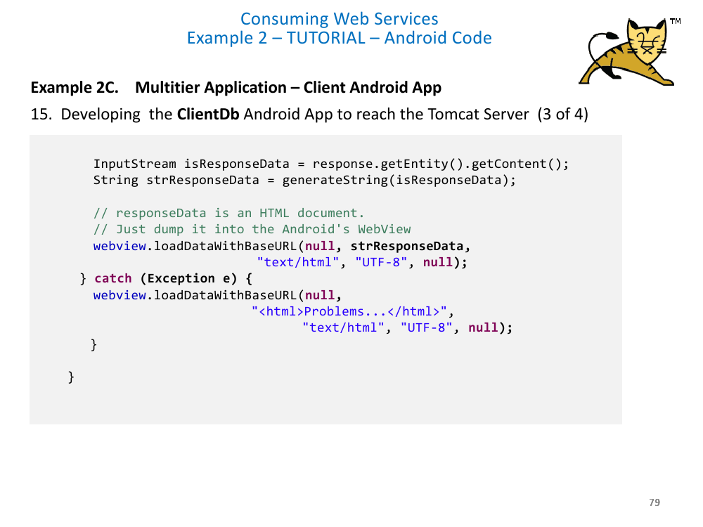

Slide 26
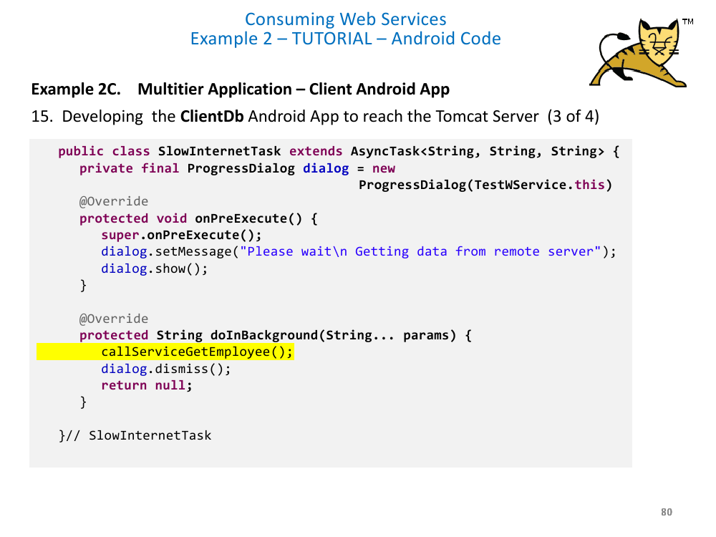

Slide 27
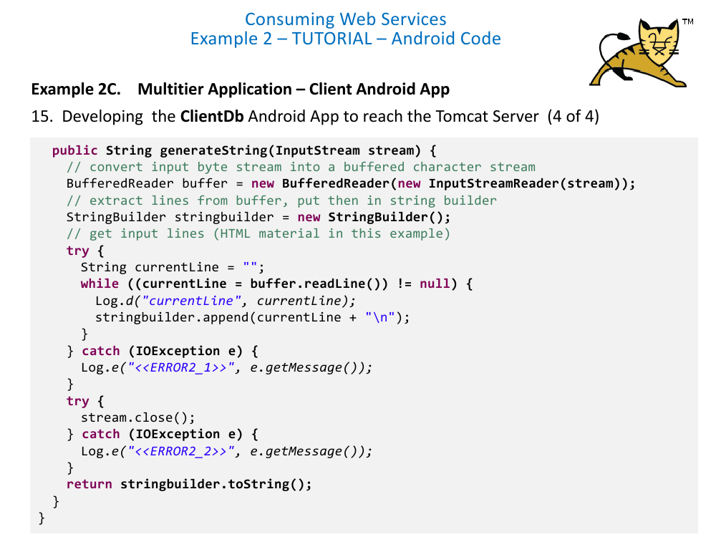

Slide 28
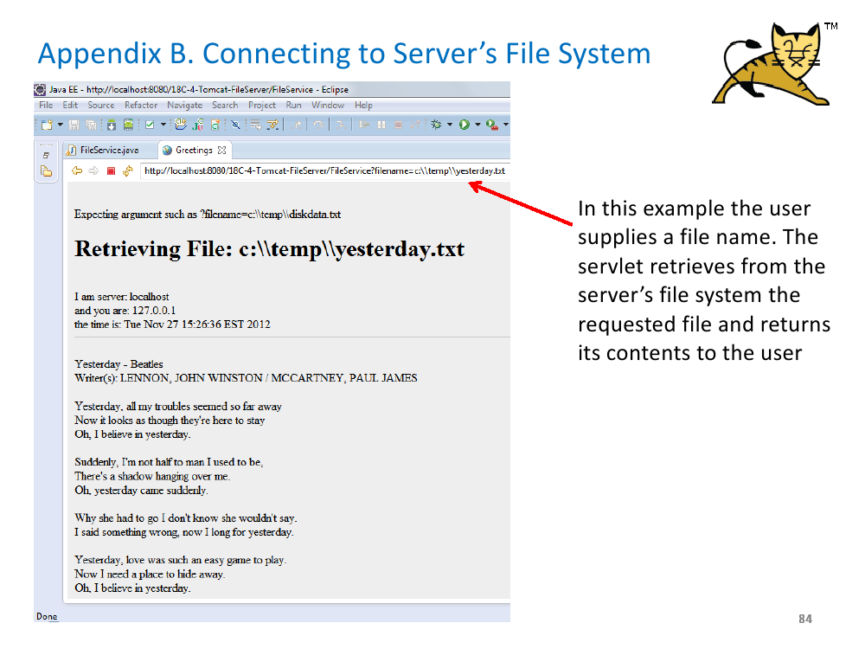

Slide 29
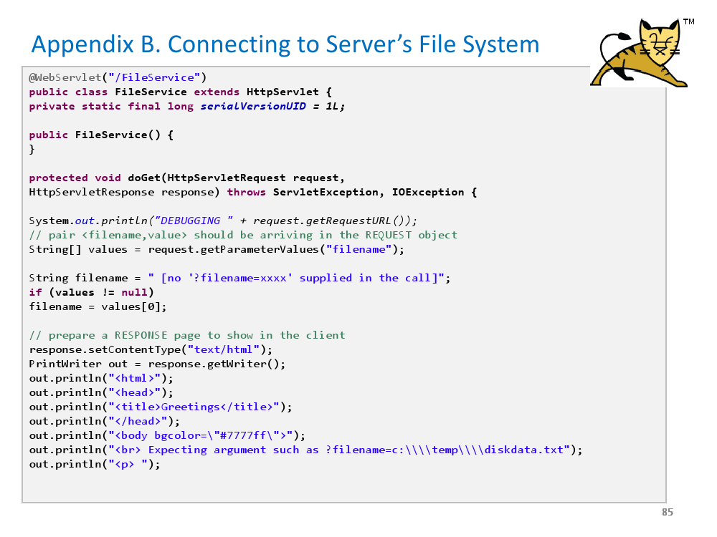

Slide 30
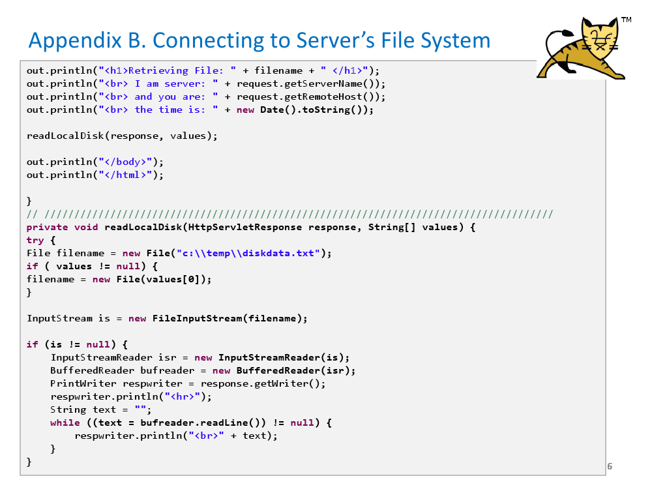

Slide 31
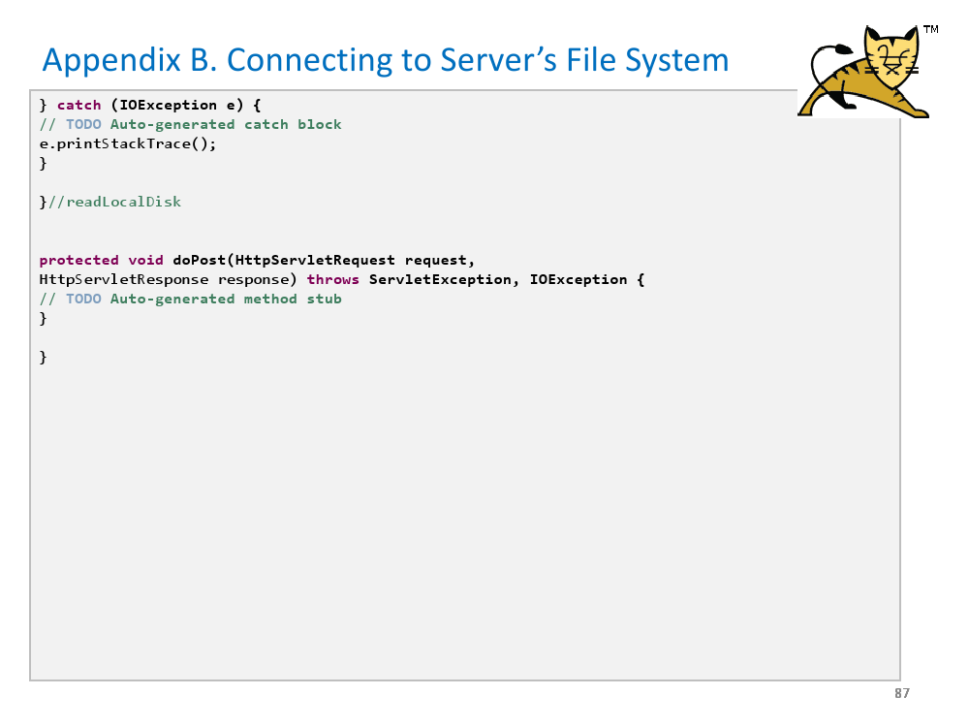

Slide 32
Using HttpConnection
J2EE
servletAuthenticate.java
Use tomcat server
Use oracle database

Slide 33
ServletAuthenticate
protected void doGet(HttpServletRequest request, HttpServletResponse response) throws ServletException, IOException {
Connection conn = null;
PreparedStatement statement = null;
ResultSet result = null;
PrintWriter out = response.getWriter();
try {
Class.forName("oracle.jdbc.driver.OracleDriver");
try {
conn = DriverManager.getConnection("jdbc:oracle:thin:@server3.imceits.mm:1521:orcl", “andd6001”,”andd6001”);
String sql = "select * from customer where name=? and password=?";
statement = conn.prepareStatement(sql);
String name = request.getParameter(“name");
String pw = request.getParameter("pass");
statement.setString(1, name);
statement.setString(2, pw);
result = statement.executeQuery();
if(result.next()) out.println(“Login Success");
else out.println(“Login Fail");
} catch (SQLException e) { }

